Slide 1
语用学
Anqi Zhang
Nanjing University
Introduction to Linguistics, Fall 2022，Nov 25, 2022

Slide 2
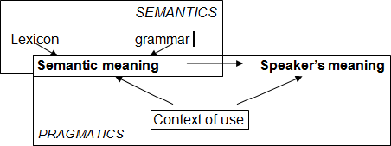
语义学和语用学
Review Inference Tests for Differentiating these Three Types Cooperative Principles Gricean Maxims Flo

Slide 3
推论
Review Inference Tests for Differentiating these Three Types Cooperative Principles Gricean Maxims Flo
当我们听到一个句子，我们经常会得出某些超出字面句义的结论
e.g. I can’t open that stupid jar.
我们可以推测，说话人很沮丧
我们相信这类额外结论为真，它们被称为推论（Inference）

Slide 4
考虑如下例子
Review Inference Tests for Differentiating these Three Types Cooperative Principles Gricean Maxims Flo
a. Aristotle is a Greek philosopher
Aristotle is a philosopher.
a. The king of France is bald.
There is a king of France.
a. Russel studied references too.
Someone else studied references.
注意，我们关于这些推论的推理有何不同？

Slide 5
推论的常见类型
Review Inference Tests for Differentiating these Three Types Cooperative Principles Gricean Maxims Flo
衍推（Entailment）：通过逻辑关系推论
预设（Presupposition）：通过我们假设成立的背景知识推论
涵义（Implicature）：
通过某些遣词方式或者会话合作原则（格莱斯准则Gricean maxims）作出的推论

Slide 6
衍推
Review Inference Tests for Differentiating these Three Types Cooperative Principles Gricean Maxims Flo
一个命题衍推其他命题，如果第一个命题为真担保了（guarantee）第二个句子为真，亦即在第一个句子为真的所有情况下，第二个句子也为真

Slide 7
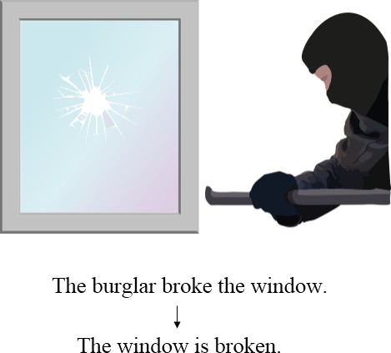
衍推
Review Inference Tests for Differentiating these Three Types Cooperative Principles Gricean Maxims Flo

Slide 8
衍推
Review Inference Tests for Differentiating these Three Types Cooperative Principles Gricean Maxims Flo
句子
Daryl is a famous hunter. 衍推句子
Daryl is a hunter.
然而，第二个句子不衍推第一个句子……

Slide 9
Review Inference Tests for Differentiating these Three Types Cooperative Principles Gricean Maxims Flo
衍推
说话人知道这些衍推关系，尽管他们可能不知道这些句子本身为真或为假

Slide 10
Review Inference Tests for Differentiating these Three Types Cooperative Principles Gricean Maxims Flo
预设
一个命题预设另一个命题，如果为使第一个句子为真或为假（有真值），第二个句子必须为真

Slide 11
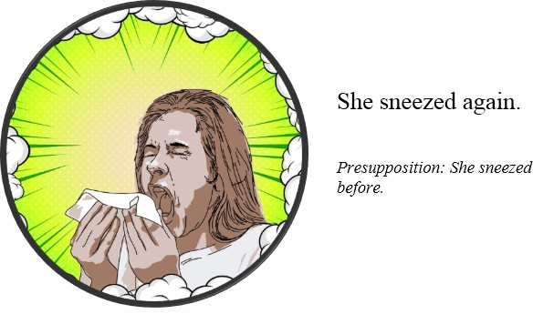
预设
Review Inference Tests for Differentiating these Three Types Cooperative Principles Gricean Maxims Flo

Slide 12
Review Inference Tests for Differentiating these Three Types Cooperative Principles Gricean Maxims Flo
这话好说得出口吗？
别犯蠢了！

Slide 13
Review Inference Tests for Differentiating these Three Types Cooperative Principles Gricean Maxims Flo
这样说呢？
学聪明点！

Slide 14
预设触发语
Review Inference Tests for Differentiating these Three Types Cooperative Principles Gricean Maxims Flo
某些词语经常会触发预设 有定限定词：the
实义动词：know. . .
stop
manage
. . .

Slide 15
推论的种类
Review Inference Tests for Differentiating these Three Types Cooperative Principles Gricean Maxims Flo
考虑如下句子的衍推和预设：
他再也不说人闲话了
这句话衍推：他现在不说人闲话
这句话预设：他之前老是说人闲话

Slide 16
涵义
Review Inference Tests for Differentiating these Three Types Cooperative Principles Gricean Maxims Flo
规约涵义（Conventional Implicatures）
是词项或表达的既定语义的一部分，而不是从语言运用的原则推出的，
并且，
不是该词项或表达的真值条件的一部分
会话涵义（Conversational Implicatures）
源自说话言辞，而不是句子 从格莱斯准则（Gricean Maxims）推出

Slide 17
涵义的例子
Review Inference Tests for Differentiating these Three Types Cooperative Principles Gricean Maxims Flo
规约涵义：
I can’t open that stupid jar.
会话涵义：
a. Will the plane arrive on time tonight?
b. The weather forecast says that there is a big snow storm later this afternoon.
从a可以推出飞机不会准点抵达

Slide 18
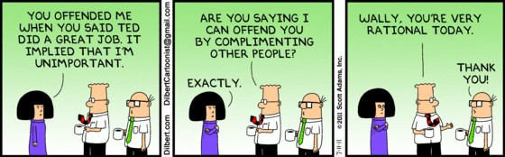
涵义：可能想得太多
Review Inference Tests for Differentiating these Three Types Cooperative Principles Gricean Maxims Flo

Slide 19
如何区分三种推论？
Review Inference Tests for Differentiating these Three Types Cooperative Principles Gricean Maxims Flo
我们如何区分三种推论？
就像句法课上决定组构成分一样，我们可以设计一些语言学测试

Slide 20
区分推论类型的测试
Review Inference Tests for Differentiating these Three Types Cooperative Principles Gricean Maxims Flo
常见的测试类型
否定/疑问测试：只有预设能通过
“等一下”测试：预设
可取消性：涵义可能被取消

Slide 21
预设始终存在
Review Inference Tests for Differentiating these Three Types Cooperative Principles Gricean Maxims Flo
设想如下对话：
(6) a. You stopped gossiping.
b. That’s not true!
如果一个句子预设了其他句子，为使前者为真或为假，后者必须为真。b说前者为假，就是在承认预设为真（否定保存现象）

Slide 22
否定和疑问
Review Inference Tests for Differentiating these Three Types Cooperative Principles Gricean Maxims Flo
无论是否定这个句子，还是对这个句子提问，预设始终都存在：
You didn’t stop gossiping. Did you stop gossiping?

Slide 23
衍推和预设
Review Inference Tests for Differentiating these Three Types Cooperative Principles Gricean Maxims Flo
既然听话人事实上从不说人闲话，原句是不适宜的（infelicitous）
#You stopped gossiping.

Slide 24
预设和否定
Review Inference Tests for Differentiating these Three Types Cooperative Principles Gricean Maxims Flo
否定测试可以用于区分预设vs衍推和涵义
纵使句子被否定，预设仍然存在；衍推和涵义则不是这样

Slide 25
预设和否定
Review Inference Tests for Differentiating these Three Types Cooperative Principles Gricean Maxims Flo
He stopped gossiping.
衍推：He doesn’t currently gossip. 预设：He used to gossip.
He didn’t stop gossiping.
相反衍推：He currently gossips. 相同预设：He used to gossip.

Slide 26
“等一下”测试
Review Inference Tests for Differentiating these Three Types Cooperative Principles Gricean Maxims Flo
尽管我们不能通过否定取消预设，但可以用“等一下”短语，质疑听话人的预设
(7) a. I stopped going to the gym.
b. Wait a minute, I know that you have never been to a gym.

Slide 27
可取消性
Review Inference Tests for Differentiating these Three Types Cooperative Principles Gricean Maxims Flo
涵义可能被取消
Either you or your brother can have the pie, and actually both of you can have the pie.
# I stopped going to the gym, and actually I had never been to a gym before.
(10)
# Aristotle is a Greek philosopher, and actually Aristotle is not a philosopher.

Slide 28
把推论区分开来
Review Inference Tests for Differentiating these Three Types Cooperative Principles Gricean Maxims Flo
对可能是哪种推论有一个大致的了解
某些词语会触发预设 一般来说，从会话而来的推论都是会话涵义
造句测试

Slide 29
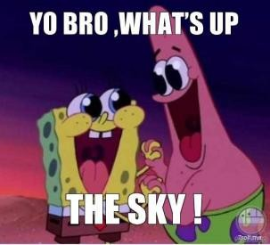
Review Inference Tests for Differentiating these Three Types Cooperative Principles Gricean Maxims Flo

Slide 30
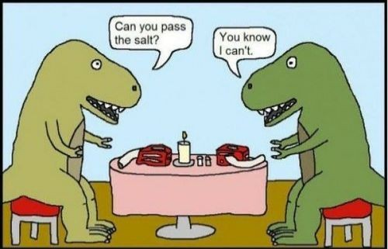
Review Inference Tests for Differentiating these Three Types Cooperative Principles Gricean Maxims Flo

Slide 31
Review Inference Tests for Differentiating these Three Types Cooperative Principles Gricean Maxims Flo
问：为什么这些对话很有趣？
答：回答出乎我们的意料

Slide 32
字面意义vs说话人意义
Review Inference Tests for Differentiating these Three Types Cooperative Principles Gricean Maxims Flo
尽管应答者按照字面意义回答，提问者期待得到的却不是这些字面回答
在交谈中，我们想要传达的经常是与字面意思有别的意义，这就是说话人意义（Speaker Meaning）
我们期待参与会话的其他人能够接收到我们想要传递的意义，并给出相应的回应（合作原则Cooperative Principle）

Slide 33
说话人意义
Review Inference Tests for Differentiating these Three Types Cooperative Principles Gricean Maxims Flo
人们在交谈中往往不止于字面意义
经由交谈，人们通常能够达成某些目标
说话人意义
如果说话人S意图通过一个言语片段U在听话人H心中产生某种效果，而听话人H又能接收到这一意图，那么说话人S通过U表达某个意义。在这种情况下，U的说话人意义就是S意图在H心中产生的效果，且H能够接收到这一意图

Slide 34
合作原则
Review Inference Tests for Differentiating these Three Types Cooperative Principles Gricean Maxims Flo
为了持续有效沟通，每一位参与者都需要：
能够意识到其他参与者在意图表达某些事情
假定其他参与者也能意识到他/她的意图
换言之，会话参与者需要合作
存在一些指导会话的普遍原则

Slide 35
格莱斯准则(Grice, 1975)
Review Inference Tests for Differentiating these Three Types Cooperative Principles Gricean Maxims Flo
当我们参与会话时，我们期待其他人能够在交流中配合协作
质真准则：真诚
适量准则：给出的信息量要适宜
关联准则：合题 方式准则：清楚明白

Slide 36
会话涵义是如何产生的？
Review Inference Tests for Differentiating these Three Types Cooperative Principles Gricean Maxims Flo
比较以下两组会话：
(11)
A: Where should we go after class? B: We can go to the Hutch.
(12)
A: Where should we go after class?
B: It’s one-dollar-shake Wednesday today.
问题：哪一组会话包含某种会话涵义？

Slide 37
会话涵义是如何产生的？
Review Inference Tests for Differentiating these Three Types Cooperative Principles Gricean Maxims Flo
当准则有可能被违反时，就会产生会话涵义
在（12）中，B没有直接回答A的问题，因为他的回答看起来与题无关。然而结合语境来看，假设B是合作的，A可以接受并重新解释B的回答，借以使得B的回答合题。A可以推断B在暗示他们应该去Hutch

Slide 38
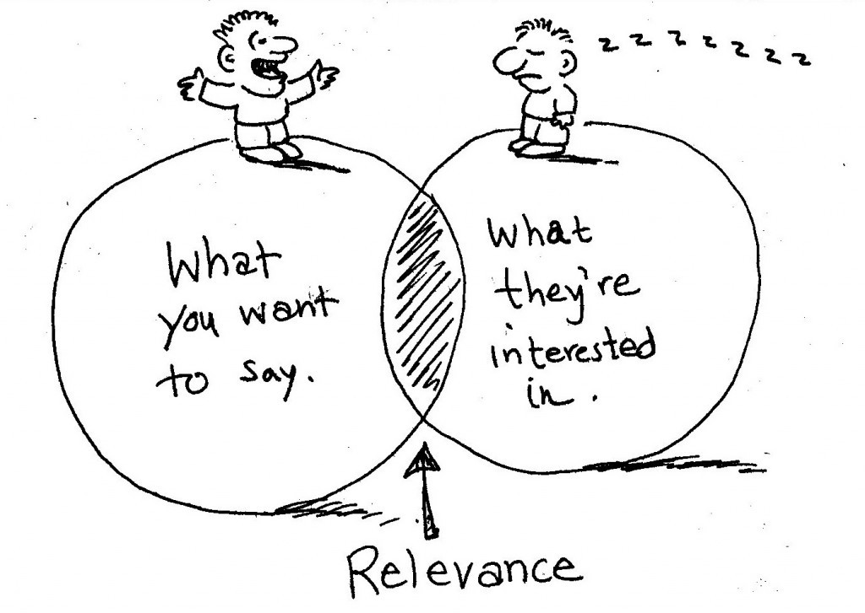
Review Inference Tests for Differentiating these Three Types Cooperative Principles Gricean Maxims Flo
相关准则
合题

Slide 39
质真准则
Review Inference Tests for Differentiating these Three Types Cooperative Principles Gricean Maxims Flo
所属准则（Supermaxim）
尽力真诚地参与会话
子准则（Submaxims）
不要说你不相信的话 不要说任何缺乏足够证据的话

Slide 40

Review Inference Tests for Differentiating these Three Types Cooperative Principles Gricean Maxims Flo

Slide 41
适量准则
Review Inference Tests for Differentiating these Three Types Cooperative Principles Gricean Maxims Flo
在参与会话时按照对方的需要提供信息（以达到当前交际的目的）
不要提供多于对方需要的信息

Slide 42
考虑从如下会话：
Review Inference Tests for Differentiating these Three Types Cooperative Principles Gricean Maxims Flo
假设两组会话都发生在美国
(13)
A: Where is Anqi from?
B: Somewhere south in China.
(14)
A: Where is Brandon from?
B: Somewhere south in the US.
问题：你觉得哪组会话包含了某种会话涵义？为什么？

Slide 43
语境和背景知识很重要
Review Inference Tests for Differentiating these Three Types Cooperative Principles Gricean Maxims Flo
尽管在两组会话中，B的回答提供了同等量的信息，然而B的回答似乎只有在第二组会话中才有涵义
这是因为在两组会话中，A期待从B获取的信息的量是不同的
这是因为A和B对美国州市的情况更熟悉，对中国省市则不那么熟悉

Slide 44
语境和背景知识很重要II
Review Inference Tests for Differentiating these Three Types Cooperative Principles Gricean Maxims Flo
关于安琪的会话似乎没有任何涵义，因为B已经给出了足够回应A的信息
我们不会获得如下涵义：要么B不知道安琪来自哪座城市，要么B不大愿意让A知道安琪来自哪座城市

Slide 45
语境和背景知识很重要III
Review Inference Tests for Differentiating these Three Types Cooperative Principles Gricean Maxims Flo
然而，在第二组会话中B关于Brandon的回答似乎有某些涵义
要么B不知道Brandon具体来自哪个州/城市，要么B有点不愿意让A知道关于Brandon的信息。这种涵义之所以会产生，是因为B的回答没有包含A预期的信息量
假设B在会话中是合作的，并遵守适量准则。为了不违反质真准则，B没有办法遵守适量准则，即B已经给出了他所知道或他能够说出的所有信息

Slide 46
级差涵义
Review Inference Tests for Differentiating these Three Types Cooperative Principles Gricean Maxims Flo
英语中的某些词项被称为“级差词项”，因为它们可以分级排列
(15)
some < all
or < both
numbers: 1<2 <3 . . .
当使用级数较低的词项以代替级数较高的词项时，如下的涵义就产生了：如果使用的是级数较高的词项，那么这个陈述为假

Slide 47
一些：一些而不是所有？
Review Inference Tests for Differentiating these Three Types Cooperative Principles Gricean Maxims Flo
如果有人说出诸如（16a）的句子，他实际上想说的有可能是（16b）
Some pandas are on the tree.
Some but not all the pandas are on the tree.
(16)
英语中的“some”似乎指的是“一些而不是所有”

Slide 48
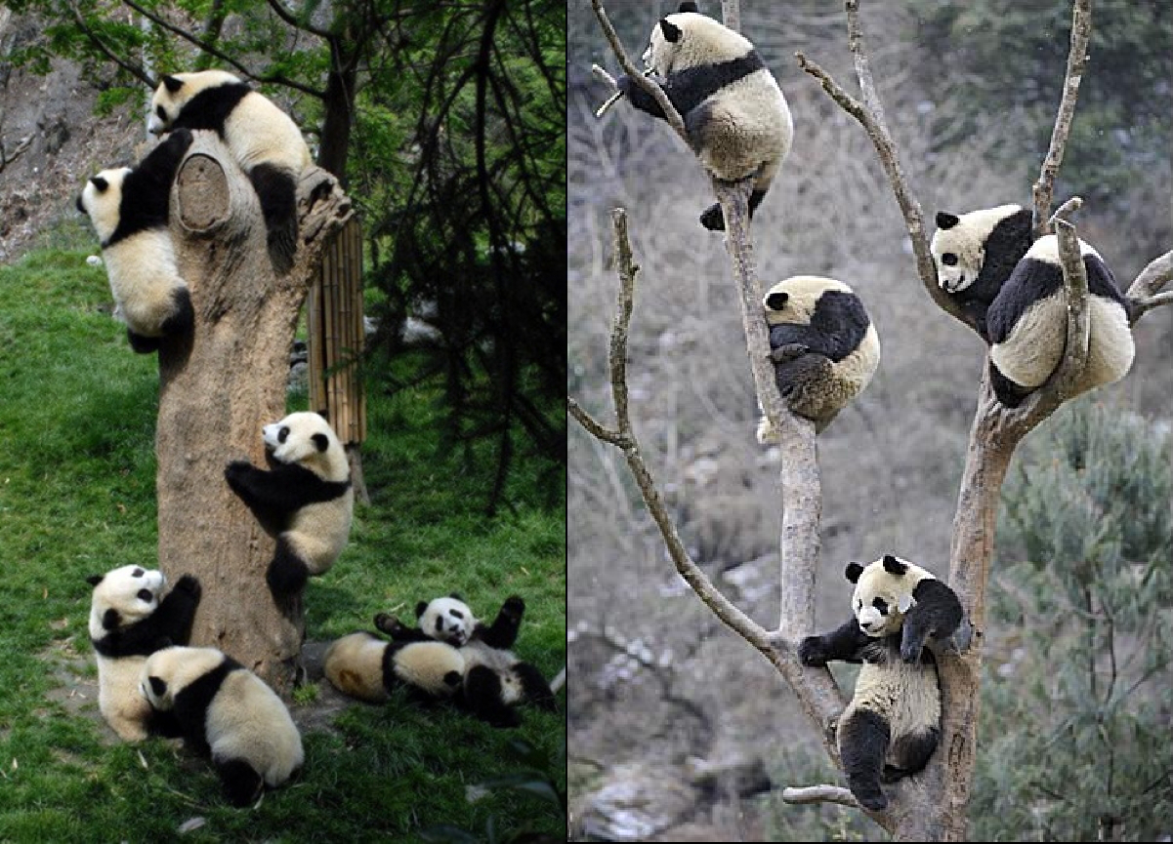
Review Inference Tests for Differentiating these Three Types Cooperative Principles Gricean Maxims Flo

Slide 49
一些且可能所有
Review Inference Tests for Differentiating these Three Types Cooperative Principles Gricean Maxims Flo
然而，这种“一些而非所有”的语义是可以被取消的（cancelable）
(17)
Some pandas are on the tree, and actually all of them are.
这种涵义不一定总能存在
(18)
If some pandas are on the tree, then I will take some pictures.

Slide 50
一些且可能所有
Review Inference Tests for Differentiating these Three Types Cooperative Principles Gricean Maxims Flo
Some pandas are on the tree.
All pandas are on the trees.
(19)
我们能理解“一些而非所有”的语义，因为说话人本可以说出句子（19b）而提供更多信息，但他却不这样做。所以，假设他遵循适量原则和质真原则，他一定没有足够的信息以说出（19b），因此涵义是（19b）为假

Slide 51
其他级差词项的类似之处
Review Inference Tests for Differentiating these Three Types Cooperative Principles Gricean Maxims Flo
如果说话人选择说句子（a）而不是信息量更大的句子（b），那么他/她可能在暗示句子（b）为假
(20)
You can have ice-cream or chocolate brownies for dessert tonight.
You can have ice-cream and chocolate brownies for dessert tonight
Implicature: You cannot have both for dessert tonight.
There are 3 pandas on the tree.
There are 4 pandas on the tree.
Implicature: There are no more than 3 pandas on the tree.
(21)

Slide 52
方式准则
Review Inference Tests for Differentiating these Three Types Cooperative Principles Gricean Maxims Flo
所属准则（Supermaxim）
清楚明白
子准则（Submaxims）
避免表达晦涩 避免歧义性 简短（避免啰嗦） 有序

Slide 53
方式准则
Review Inference Tests for Differentiating these Three Types Cooperative Principles Gricean Maxims Flo
(22)
A: I hear you went to the opera last night; how was the lead singer?
B: The singer produced a series of sounds corresponding closely to the score of an aria from ‘Rigoletto’. (Levinson 1983)
B无视了方式准则，以致于句子很啰嗦

Slide 54
无视准则
Review Inference Tests for Differentiating these Three Types Cooperative Principles Gricean Maxims Flo
人们经常无视格莱斯准则，以达到某种目的
说谎 回避 开玩笑
形象表达

